Slide 1
Chapter 25
Preprocessing and Feature Engineering
Junya Zhao
Md Mazharul Islam

Slide 2
Outline
Transformers
High-Level Transformers
Working with Continuous Features
Working with Categorical Features
Text Data Transformers
Feature Manipulation
Feature Selection
Advanced Topics

Slide 3
Transformers
Transformers are primarily used in preprocessing or feature generation.
Transformers are functions that convert raw data in different ways. This is used to create a new interaction variable (from two other variables), to normalize a column, or to simply turn it into a Double to be input into a model.
Spark provides a number of transformers as part of the org.apache.spark.ml.feature package. New transformers are constantly popping up in Spark. The most up-to-date information can be found on the Spark documentation site.(https://spark.apache.org/docs/latest/ml-features.html)

Slide 4
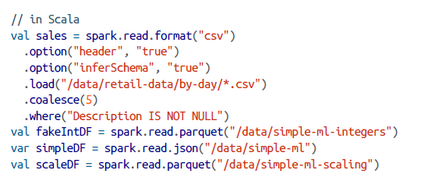

Slide 5
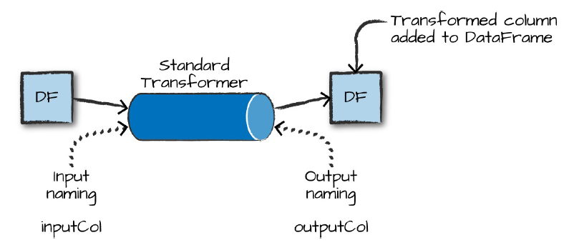
Transformers (cont.)
This figure is a simple illustration. On the left is an input DataFrame with the column to be manipulated. On the right is the input DataFrame with a new column representing the output transformation.

Slide 6
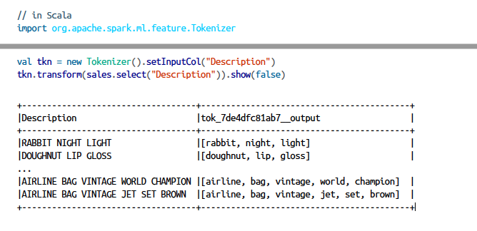
Transformers (cont.)
Tokenizer : It tokenizes a string, splitting on a given character

Slide 7
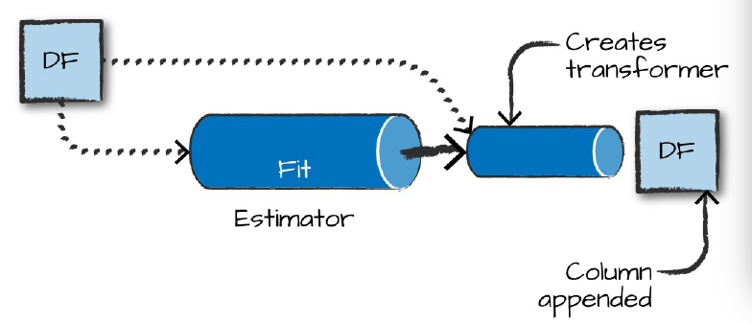
Estimators for Preprocessing
This figure is a simple illustration of an estimator fitting to a particular input dataset, generating a transformer that is then applied to the input dataset to append a new column (of the transformed data).

Slide 8
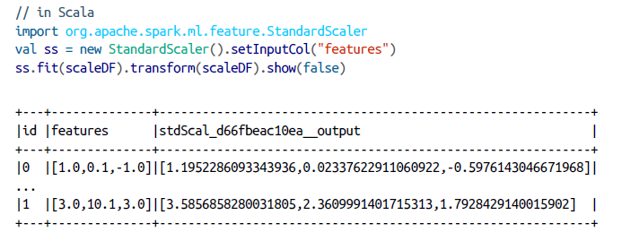
Estimators for Preprocessing (cont.)
An example of estimator is the StandardScaler, which scales your input column according to the range of values in that column to have a zero mean and a variance of 1 in each dimension. For that reason it must first perform a pass over the data to create the transformer.

Slide 9
High-Level Transformers
High-level allow you to concisely specify a number of transformations in one.
Allow you to avoid doing data manipulations or transformations one by one.
In general, you should try to use the highest level transformers you can, in order to minimize the risk of error and help you focus on the business problem instead of the smaller details of implementation.

Slide 10
High-Level Transformers
RFormula
SQL Transformers
VectorAssembler

Slide 11
RFormula
The RFormula is the easiest transformer to use when you have “conventionally” formatted data.
Spark borrows this transformer from the R language to make it simple to declaratively specify a set of transformations for your data.
With this transformer, values can be either numerical or categorical and you do not need to extract values from strings or manipulate them in any way.
The RFormula will automatically handle categorical inputs (specified as strings) by performing function called one-hot encoding. In brief, it converts a set of values into a set of binary columns. (we’ll discuss more later in this chapter).
With the RFormula, numeric columns will be cast to Double. If the label column is of type String, it will be first transformed to Double with StringIndexer. (we’ll discuss more later this chapter).

Slide 12
High-Level Transformers (cont.)
RFormula
SQL Transformers
VectorAssembler

Slide 13
SQL Transformers
A SQLTransformer allows you to leverage Spark’s vast library of SQL-related manipulations
Any SELECT statement you can use in SQL is a valid transformation.
The only thing you need to change is that instead of using the table name, you should just use the keyword THIS.
Use SQLTransformer to formally codify the DataFrame manipulation as a preprocessing step, or try different SQL expressions for features during hyperparameter tuning.
Note that the output of this transformation will be appended as a column to the output DataFrame.
Use an SQLTransformer in order to represent all of your manipulations on the very rawest form of your data so you can version different variations of manipulations as transformers.
This gives you the benefit of building and testing varying pipelines, all by simply swapping out transformers.

Slide 14
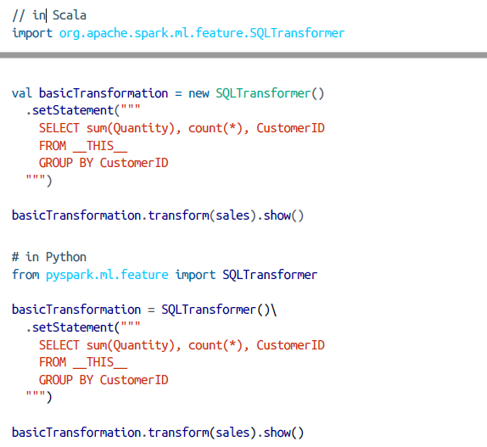
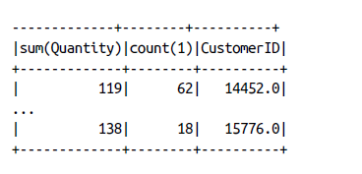
SQL Transformers (cont.)
The following is a basic example of using SQLTransformer:

Slide 15
High-Level Transformers (cont.)
RFormula
SQL Transformers
VectorAssembler

Slide 16
VectorAssembler
The VectorAssembler helps concatenate all your features into one big vector then the user can pass it into an estimator.
It’s used typically in the last step of a machine learning pipeline.
This is particularly helpful if you’re going to perform a number of manipulations using a variety of transformers and need to gather all of those results together.

Slide 17
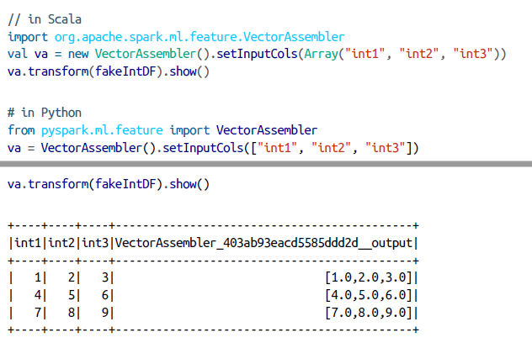
VectorAssembler (cont.)
The output from the following code snippet will make it clear how this works:

Slide 18
Working with Continuous Features
Bucketing
Scaling and Normalization
StandardScaler

Slide 19
Bucketing
The most straightforward approach to bucketing or binning is using the Bucketizer.
This will split a given continuous feature into the buckets of your designation. You specify how buckets should be created via an array or list of Double values.
This is useful because you may want to simplify the features in your dataset or simplify their representations for interpretation later on.
For example, imagine you have a column that represents a person’s weight and you would like to predict some value based on this information. In some cases, it might be simpler to create three buckets of “overweight,” “average,” and “underweight.”

Slide 20
Bucketing(cont.)
When specifying your bucket points, the values you pass into splits must satisfy three requirements:
The minimum value in your splits array must be less than the minimum value in your DataFrame.
The maximum value in your splits array must be greater than the maximum value in your DataFrame.
You need to specify at a minimum three values in the splits array, which creates two buckets.
For example, setting splits to 5.0, 10.0, 250.0 on the dataframe will actually fail because it doesn’t cover all possible input ranges.

Slide 21
Bucketing(cont.)
To cover all possible ranges, scala.Double.NegativeInfinity is another split option. It can cover all possible ranges outside of the inner splits.
In order to handle null or NaN values, we must specify the handleInvalid parameter as a certain value.

Slide 22
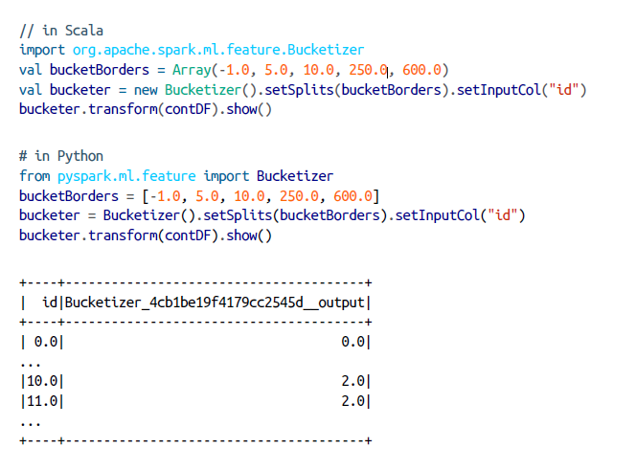
Bucketing(cont.)
Here is an example :

Slide 23
Bucketing(cont.)
Another option is to split based on percentiles in our data. This is done with QuantileDiscretizer, which will bucket the values into user-specified buckets with the splits being determined by approximate quantiles values.
For instance, the 90th quantile is the point in your data at which 90% of the data is below that value. You can control how finely the buckets should be split by setting the relative error for the approximate quantiles calculation using setRelativeError. Spark does this is by allowing you to specify the number of buckets you would like out of the data and it will split up your data accordingly.

Slide 24
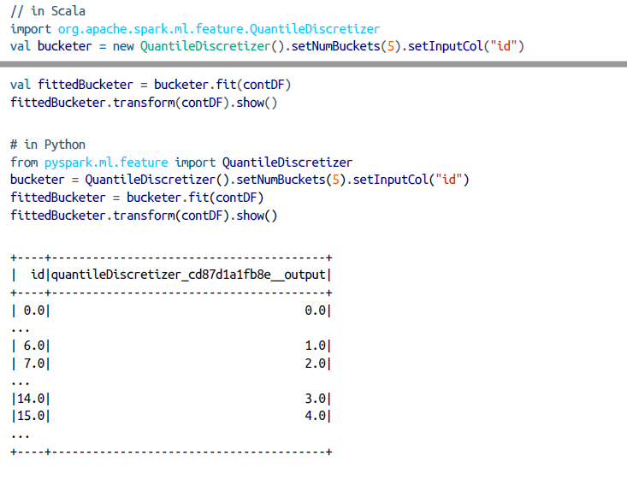
Bucketing(cont.)

Slide 25
Working with Continuous Features
Bucketing
Scaling and Normalization
StandardScaler

Slide 26
Scaling and Normalization
Another common task is to scale and normalize continuous data.
Use this when the data contains a number of columns based on different scales.
For instance, say we have a DataFrame with two columns: weight (in ounces) and height (in feet). If we don’t scale or normalize, the algorithm will be less sensitive to variations in height because height values in feet are much lower than weight values in ounces.
Normalization might involve transforming the data so that each point’s value is a
Representation of its distance from the mean of that column.
For example, if we want to know how far a given individual’s height is from the mean height.

Slide 27
Scaling and Normalization (cont.)
The fundamental goal—we want our data on the same scale so that values can easily be compared to one another in a sensible way.
InMLlib, will look across all the rows in a given column (of type Vector) and then treat every dimension in those vectors as its own particular column.
It will then apply the scaling or normalization function on each dimension separately.
A simple example might be the following vectors in a column:
1,2
3,4
When we apply our scaling function, the “3” and the “1” will be adjusted
while the “2” and the “4” will be adjusted according to one another.
This is commonly referred to as component-wise comparisons.

Slide 28
Working with Continuous Features
Bucketing
Scaling and Normalization
StandardScaler

Slide 29
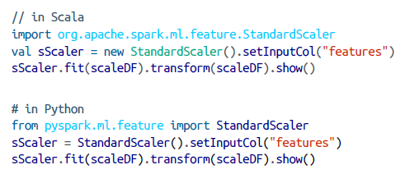
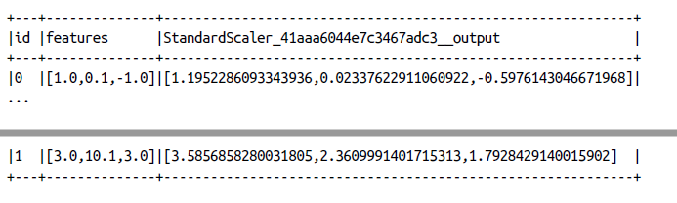
StandardScaler
The StandardScaler standardizes a set of features to have zero mean and a standard deviation of 1.
The flag withStd will scale the data to unit standard deviation while the flag withMean will center the data prior to scaling it

Slide 30
StandardScaler (cont.)
MinMaxScaler
MaxAbsScaler
ElementwiseProduct
Normalizer

Slide 31
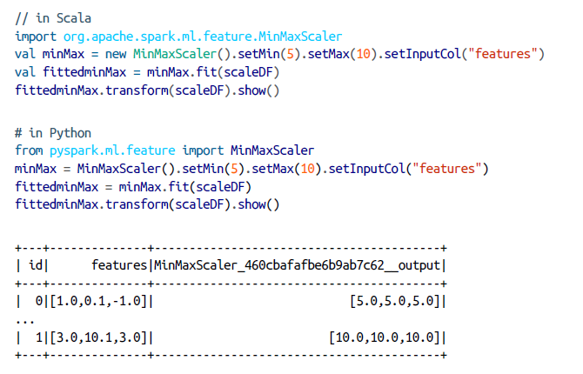
StandardScaler (cont.)
MinMaxScaler

Slide 32
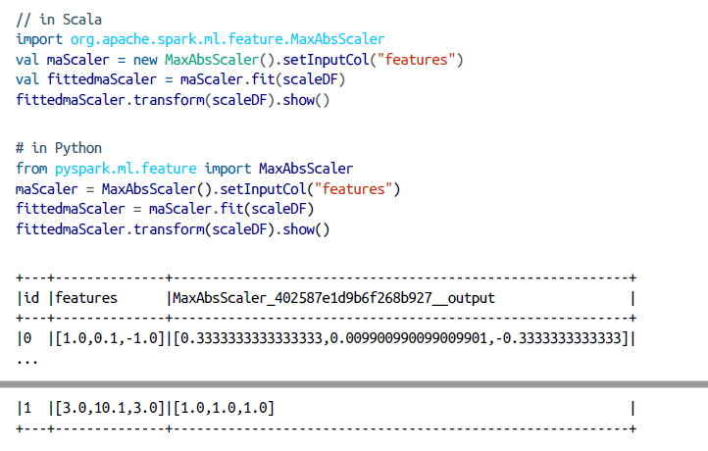
StandardScaler (cont.)
MaxAbsScaler

Slide 33
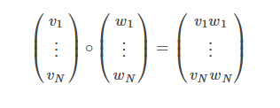
StandardScaler (cont.)
ElementwiseProduct
multiplies each input vector by a provided “weight” vector.
In other words, it scales each column of the dataset by a scalar multiplier.
ElementwiseProduct

Slide 34
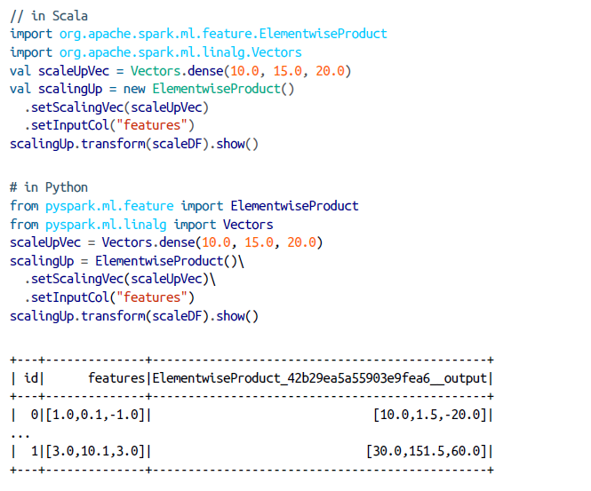
StandardScaler (cont.)
ElementwiseProduct

Slide 35
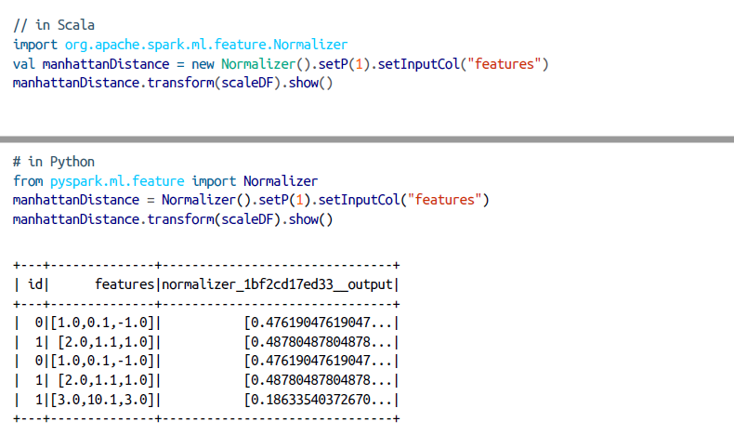
StandardScaler (cont.)
Normalizer

Slide 36
Working with Categorical Features
StringIndexer
Converting Indexed Values Back to Text
Indexing in Vectors
One-Hot Encoding

Slide 37
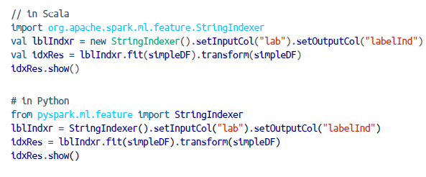
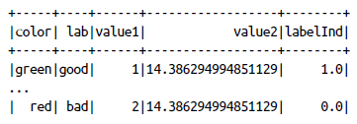
StringIndexer
Maps strings to different numerical IDs.
Spark’s StringIndexer creates metadata attached to the Dataframe that specify what inputs correspond to what outputs.
StringIndexer can be applied to columns that are not strings, in which case, they will be converted to strings before being indexed.

Slide 38
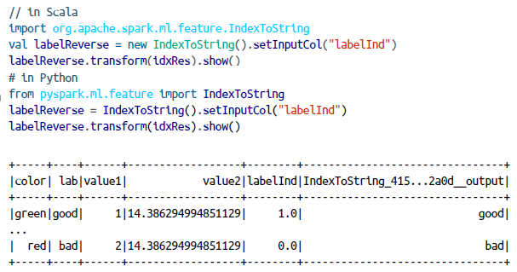
Converting Indexed Values Back to Text
IndexToString converts indexed values back to text.
We do not have to input our value to the String key; Spark’s MLlib maintains this metadata .

Slide 39
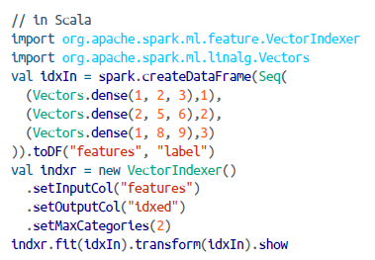
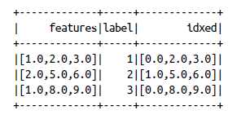
Indexing in Vectors
VectorIndexer is a helpful tool for working with categorical variables that are already found inside of vectors in the dataset.
This tool will automatically find categorical features inside of the input vectors and convert them to categorical features with zero-based category indices.

Slide 40
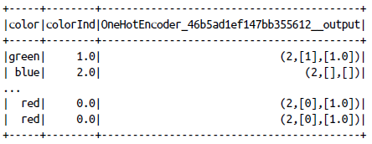
One –Hot Encoding
One-hot encoding is an extremely common data transformation performed after indexing categorical variables.
This is because indexing does not always represent our categorical variables in the correct way for downstream models to process.
OneHotEncoder, which will convert each distinct value to a Boolean flag (1 or 0) as a component in a vector
When we encode the color value, then we can see these are no longer ordered, making them easier for downstream models

Slide 41
Text Data Transformers
Text Data Transformation is needed for Machine Learning model to use Text effectively.
Two types of texts : Free-form text and string categorical variables.
This section we focused on free-form text.

Slide 42
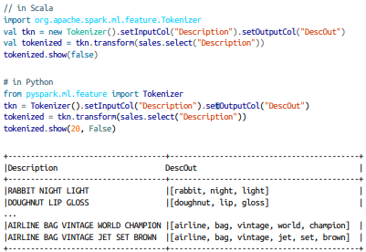
Tokenizing Text
Converts free form texts to “Tokens” or individual words.
Tokenizer class is the easiest way to do this transformation.
This class separates a string of words by whitespace and converts them into array of words.

Slide 43
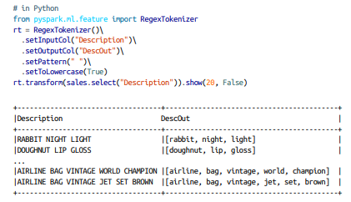
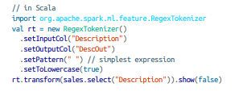
Tokenizing Text(contd.)
We can also create a Tokenizer that is not just based white space but a regular expression with the RegexTokenizer
The format of the regular expression should conform to the Java Regular Expression (RegEx) syntax

Slide 44
Removing Common Words
A common task after tokenization is to filter stop words.
Stop words are the common words that are not relevant in many kinds of analysis.
Example: the, and, but
Spark contains a list of default stop words

Slide 45
Creating Word Combinations
After Tokenizing and filtering stop words we get clean set of words to use as feature.
Word combinations are technically referred to as n-grams (sequences of words of length n)
n-gram of length 1 is called unigrams, those of length 2 are called bigrams, and those of length 3 are called trigrams.
Order matters in n-gram creation.
So converting a sentence with three words into bigram representation would result in two bigrams.

Slide 46
Creating Word Combinations
The bigrams of “Big Data Processing Made Simple” are:
“Big Data”
“Data Processing”
“Processing Made”
“Made Simple”
The trigrams are :
“Big Data Processing”
“Data Processing Made”
“Processing Made Simple”

Slide 47
Converting words into numerical Representations
Simplest way is just to include binary counts of a word in a given document (in our case, a row) by measuring whether or not each row contains a given word.
In addition, we can count words using a CountVectorizer.
A CountVectorizer does two things while operating on tokenized data:
During the fit process, it finds the set of words in all the documents and then counts the occurrences of those words in those documents.
It then counts the occurrences of a given word in each row of the DataFrame column during the transformation process and outputs a vector with the terms that occur in that row.

Slide 48
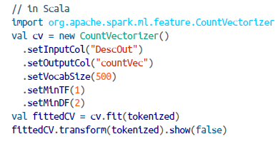
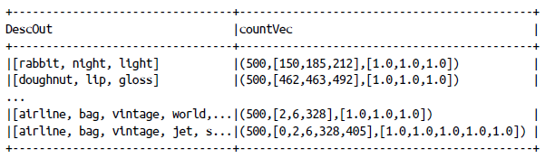
Converting words into numerical Representations(cont.)
CountVectorizer treats every row as a Document and every word as a term
The total collection of all terms is Vocabulary

Slide 49
Term Frequency-inverse document frequency(TF-IDF)
Another way to approach the problem of converting text into a numerical representation.
TF–IDF measures how often a word occurs in each document, weighted according to how many documents that word occurs in.
Words that occur in a few documents are given more weight than words that occur in many documents
In practice, a word like “the” would be weighted very low.
TF–IDF helps find documents that share similar topics.

Slide 50
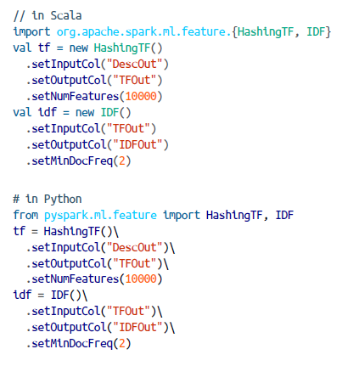
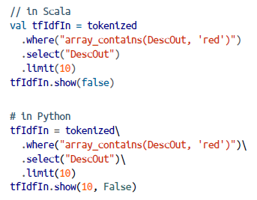
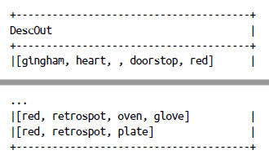
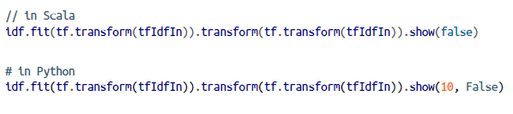

TF-IDF(Cont.)

Slide 51
Word2Vec
Word2Vec is a deep learning–based tool for computing a vector representation of a set of words
The goal is to have similar words close to one another in this vector space
Word2Vec is notable for capturing relationships between words based on their semantics
Word2Vec uses a technique called “skip-grams” to convert a sentence of words into a vector representation.

Slide 52
Word2Vec (Cont.)
Steps for converting a sentence of words into a vector representation
Builds a vocabulary
Removes a token
Trains the model to predict the missing token in the “n-gram” representation.

Slide 53
Feature Manipulation
PCA
Interaction
Polynomial Expansion

Slide 54
Principal Component Analysis (PCA)
Principal Components Analysis (PCA) is a mathematical technique for finding the most important aspects of our data (the principal components).
It changes the feature representation of our data by creating a new set of features (“aspects”).
Each new feature is a combination of the original features.
PCA is useful when we have a large input dataset is large and want to reduce the number of features.

Slide 55
Interaction
The feature transformer Interaction allows to create an interaction between two variables manually.
It just multiplies the two features together—something that a typical linear model would not do for every possible pair of features.
Currently only available directly in Scala but can be called from any language using the RFormula.

Slide 56
Polynomial Expansion
Polynomial expansion is used to generate interaction variables of all the input columns.
For a degree-2 polynomial, Spark takes every value in feature vector, multiplies it by every other value in the feature vector, and then stores the results as features
For instance, if we have two input features, we’ll get four output features if we use a second degree polynomial (2x2).

Slide 57
Feature Selection
Feature selection is the process of selecting a smaller subset from large range of possible features.
ChiSqSelector leverages a statistical test to identify features that are not independent from the label we are trying to predict, and drop the uncorrelated features.
This method is based on Chi-Sqauare Test.
Several ways of picking up best features : using numTopFeatures method, percentile and fpr

Slide 58
Advanced Topics
Persisting Transformers: To persist a transformer we can write method on the fitted transformer and specify the disk location to write it.
Writing a custom transformer: Custom transformers are valuable when we have to encode our own business logic to fit into the ML pipeline

